Slide 1
Integrating Multi-Sensor Data and Cardiovascular System Modeling for Machine Learning Based Prediction of Cardiovascular Disease
Mid Evaluation
Group 34

Slide 2
Introduction
Objective :
To develop a non-invasive, multi-sensor system that integrates physiological data like pulse waveforms (PPG), ECG, and heart sounds(PCG) with machine learning to improve early detection of cardiovascular diseases (CVD) and enhance early prediction accuracy.
Motivation :
Cardiovascular diseases have become the leading cause of death globally
Early prediction of CVD can improve patient outcomes.
ECG, PCG, and PPG carry critical diagnostic information that aid in early detection of CVD

Slide 3

Problem Statement
Current CVD diagnostics often miss early, subtle patterns in complex signals like ECGs. Manual analysis is slow and inconsistent.
This project develops an automated ML-based system to detect hidden biomarkers, enabling earlier and more accurate risk assessment for better patient care and reduced healthcare burden.

Slide 4
Literature Review

Slide 5
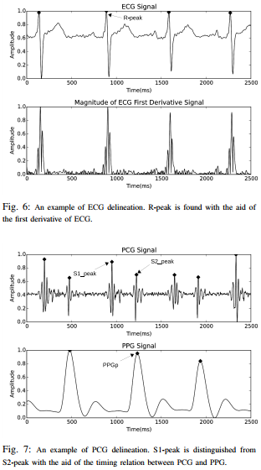
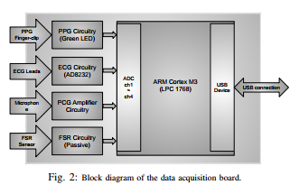
Nonlinear Cuff-less Blood Pressure Estimation of Healthy Subjects Using Pulse Transit Time and Arrival Time
(by Amir Hossein Esmaili, Mohammad Kachuee, and Mahdi Shabany)
personalized, nonlinear model using PTT/PAT to reliably estimate SBP and DBP without a cuff. It emphasizes the need for calibration per individual and shows promising results.

Slide 6
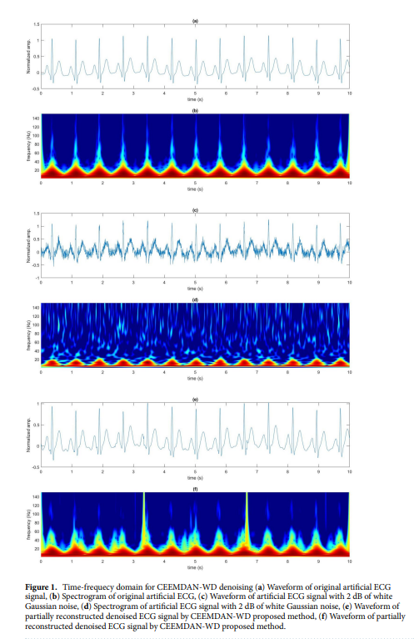
A two‑step pre‑processing tool to remove Gaussian and ectopic noise for heart rate variability analysis
(Saleem, S., Khandoker, A.H., Alkhodari, M. et al. )
Method:
CEEMDAN (Complete Ensemble Empirical Mode Decomposition with Adaptive Noise)
The ECG is broken into several layers (IMFs) from high frequency to low frequency, helping isolate noise from useful heart signal components.
SDROM‑ADF
SDROM: a rank-order statistical filter
ADF: an adaptive filter
Effectively removes abnormal heartbeat spikes
.
https://doi.org/10.1038/s41598-022-21776-2

Slide 7
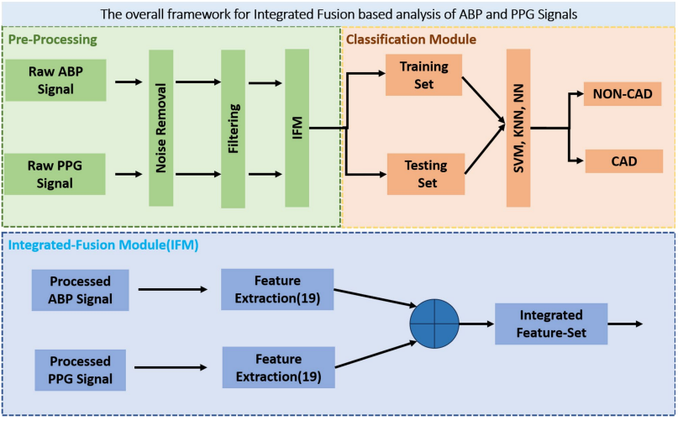

Machine learning analysis of integrated ABP and PPG signals towards early detection of coronary artery disease
By Minhas, A., Pal, S.C. & Jain, K.
Pre-processing: Removes noise/artifacts from raw signals
Integrated Fusion Module (IFM): Extracts 19 features from each signal and then fuses them into a single comprehensive feature set.
Classification Module: Uses fused features to train/test classifiers (KNN, SVM, neural networks) to distinguish CAD vs. non-CAD subjects, evaluating accuracy, sensitivity, and predictive value.
https://doi.org/10.1038/s41598-025-93390-x
‌

Slide 8
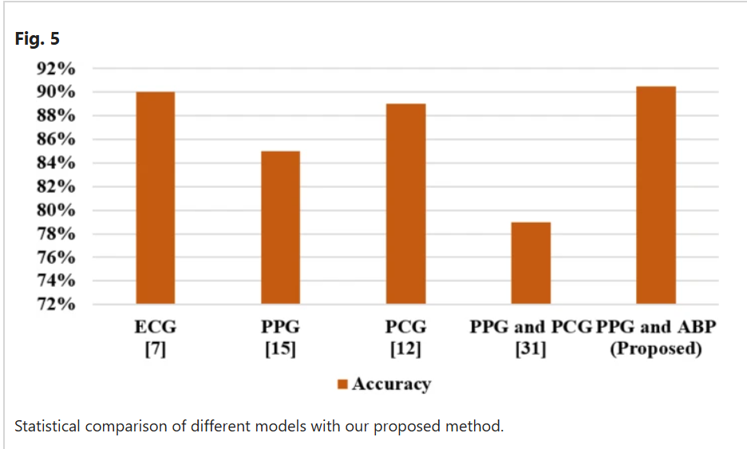

Slide 9
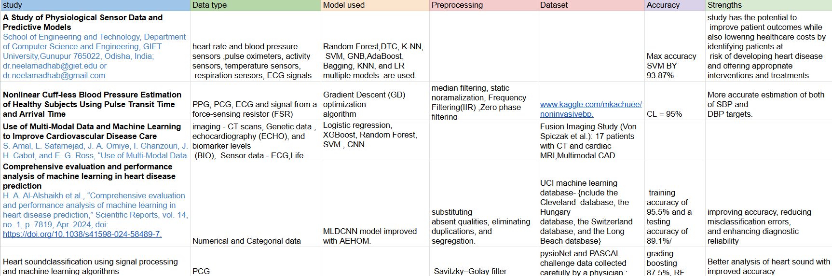
Summarize of Literature Review

Slide 10
Signal Preprocessing

Slide 11
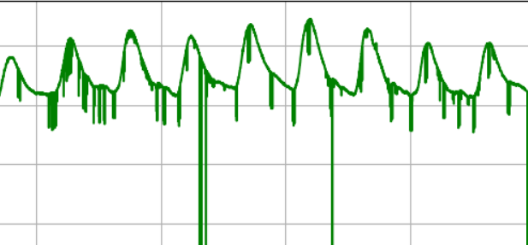
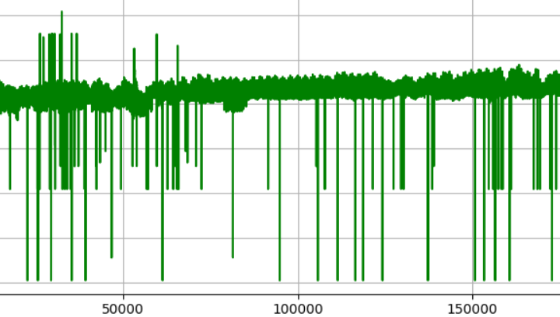
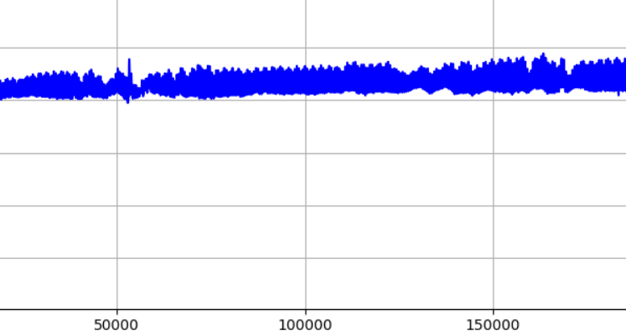
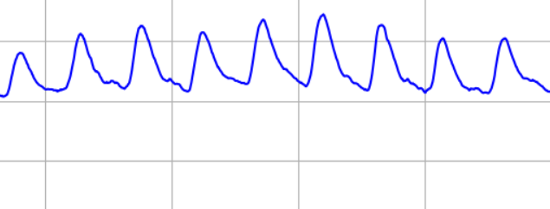
PPG PREPROCESSING
used a median filter to eliminate electric glitch noise which caused signal have large thin spikes.
Use savisky golay filter after signal is filtered by median filter to smooth the signal.
Raw ppg signal
filtered ppg signal
zoomed out of a region of a raw and filtered signal

Slide 12
ECG PREPROCESSING
Applied a median filter to the ECG signal to eliminate electrical glitch noise using a small kernel, preserving important peaks such as Q and S.
Used the BioSPPy library in Python to detect R-peaks in the ECG signal.
Marked all downward peaks on the ECG waveform.
Identified the nearest downward peaks around each R-peak as Q and S points.
Applied a low-pass filter to the ECG signal, excluding the regions around the R-peaks.
Smoothed the regioned signals using the Savitzky-Golay filter to enhance ECG clarity.

Slide 13
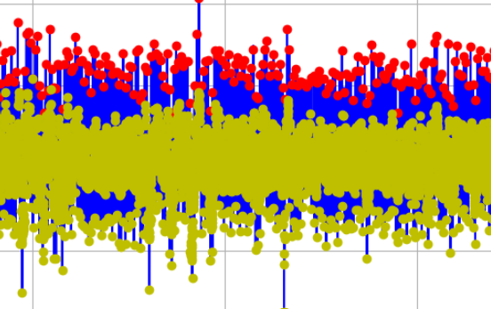
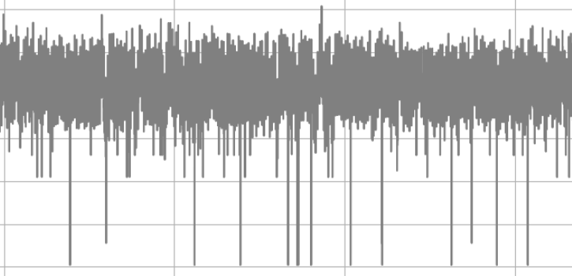
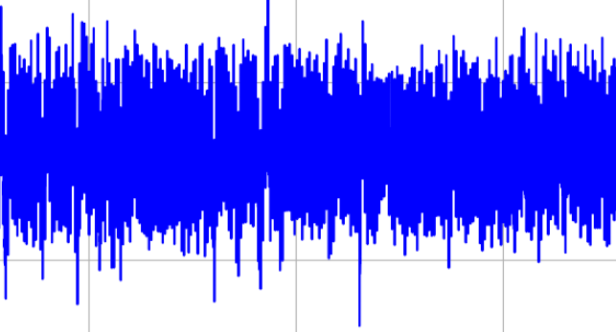
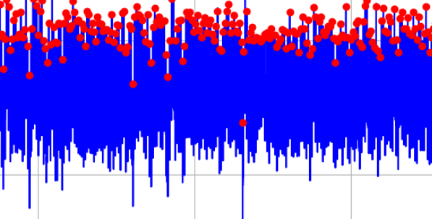
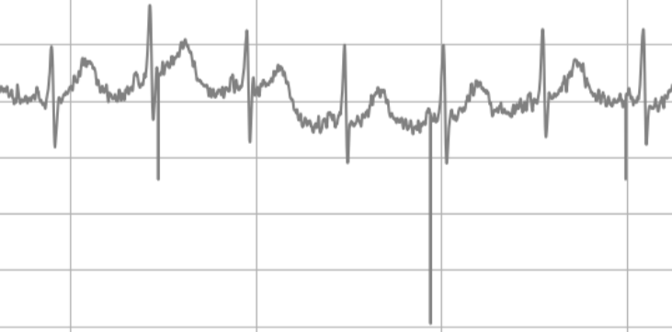
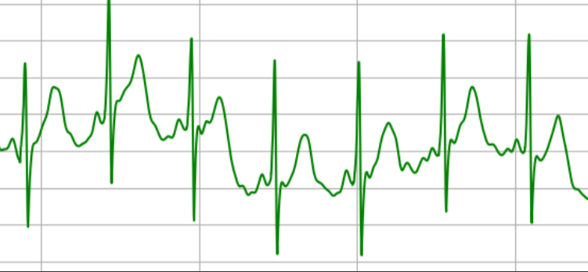
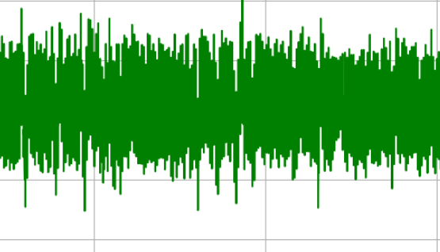
ECG PREPROCESSING
Raw ecg
median filtered ecg
R peaks point out ecg
Q,R,S point out ecg
low passed +savisky goley filtered final ecg
zoomed out ecg raw
zoomed out ecg filtered

Slide 14
Overview of the Filterers used in Preprocessing
SAVITZKY GOLAY FILTER
Great for smoothing with less distortion.
Preserves signal shape and features.
can distort the important spikes of the signal.
MEDIAN FILTER
Excellent for remove impulse noise.
preserve the important edges.
not suitable for smoothing the signal.

Slide 15
Current Implementation Status

Slide 16

Datasets used
MIT-BIH Arrhythmia database on physionet
PTB-XL a large publicly available electrocardiography dataset
Approach
Attention mechanism to focus on important time intervals of signal.
Use of Convolutional Neural Networks (CNNs) for feature extraction.
Training Parameters
Optimizer: Adam optimizer for adaptive learning.
Loss Function: Binary Crossentropy (for multi-label classification)
Metrics: Accuracy, AUC (Area Under the Curve).
Epochs: Trained for up to 50 epochs to optimize performance.
Callbacks
EarlyStopping:
ModelCheckpoint (Saves the model with the best validation loss)

Slide 17
Model Architecture : Attention-Based Deep Learning Model
Layer | Objective
Convolutional layer | Mimic how cardiologists detect local waveform features
Max-Pooling Layer | Help in handling noisy real-world signals by focusing on dominant features.
Bidirectional LSTM | processes sequential data in both forward and backward directions
Attention Layer | Highlights specific time intervals that may correspond to critical cardiac events
Dense Layer | Allow multi-condition mapping from complex signal features.
Output Layer | Sigmoid activation for multi-label classification

Slide 18
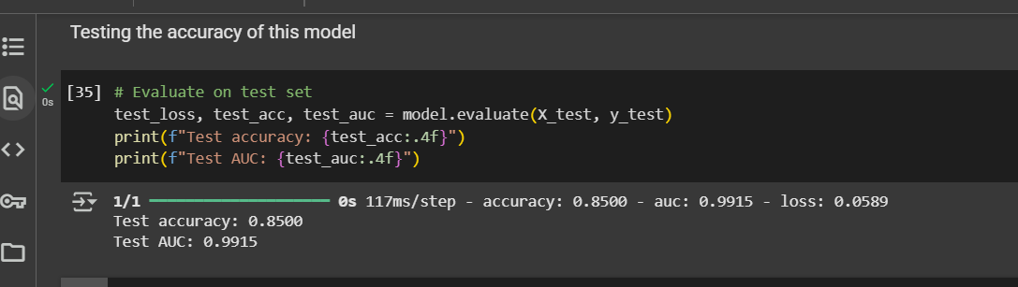
Evaluation and Results:
Metrices : Loss, Accuracy, and AUC on the test set.
According to the results up to now,
Loss = 0.0589
Accuracy 0.8500
AUC = 0.9915

Slide 19
Challenges
Requirement of Labeled Multi-Signal Datasets
Data Understanding & Preprocessing Complexity
(Each signal type requires different filtering, segmentation, and normalization techniques.)
Model Architecture Selection
(Choosing and tuning between attention models, CNNs, and transfer learning)
Lack of Unified Diagnosis
(Some datasets might be labeled only for general health status or event types, not specific CVD categories )

Slide 20
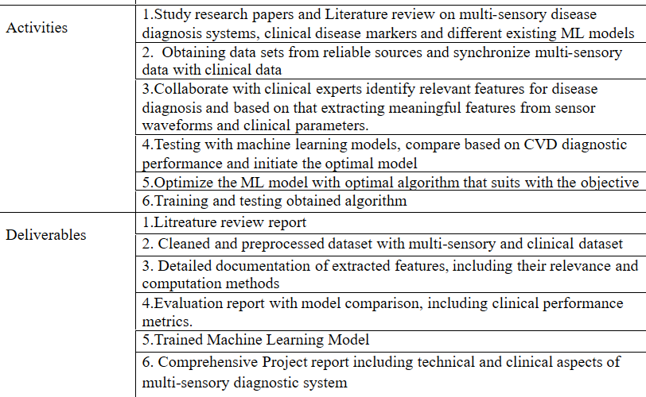
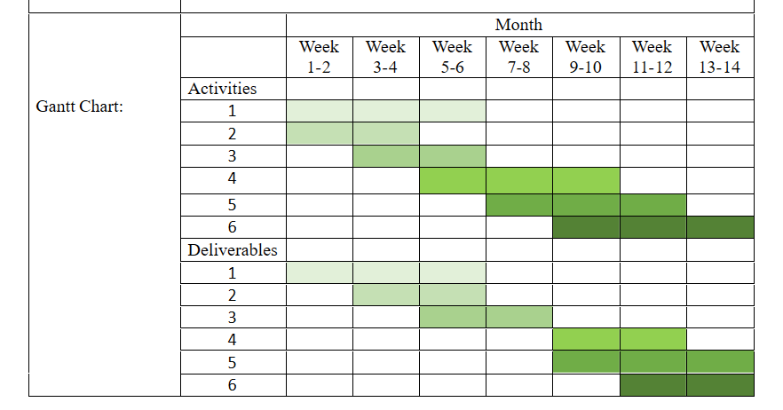
Gantt Chart

Slide 21
Work In Progress
Work planning to proceed
Continue search datasets for multi-signal inputs
Working on removing baseline wander and Gaussian noise from the signals using CEEMDAN method
Error handling and ensuring validation logic is robust
Design Fusion Strategy
planning to integrate Explainable AI (XAI) techniques into model to understand which parts of the signals influence the prediction most.
Testing Attention based model on ECG features
Extend the current architecture to accept multiple input branches
Improve generalizability of the model
Need for a preprocessing pipeline to normalize and align multi-modal signals.

Slide 22
Reference
  C. Guo, B. Yin, and J. Hu, “An Electrocardiogram Classification Using a Multiscale Convolutional Causal Attention Network,” Electronics, vol. 13, no. 2, pp. 326–326, Jan. 2024, doi: https://doi.org/10.3390/electronics13020326.
  Y. Ansari, O. Abou, K. A. Qaraqe, and Erchin Serpedin, “Deep learning for ECG Arrhythmia detection and classification: an overview of progress for period 2017–2023,” Frontiers in Physiology, vol. 14, Sep. 2023, doi: https://doi.org/10.3389/fphys.2023.1246746.
  L. Niu, C. Chen, H. Liu, S. Zhou, and M. Shu, “A Deep-Learning Approach to ECG Classification Based on Adversarial Domain Adaptation,” Healthcare, vol. 8, no. 4, p. 437, Oct. 2020, doi: https://doi.org/10.3390/healthcare8040437.
Y. Liu et al., “Generalizable Beat-by-Beat Arrhythmia Detection by Using Weakly Supervised Deep Learning,” Frontiers in Physiology, vol. 13, Mar. 2022, doi: https://doi.org/10.3389/fphys.2022.850951.
“Papers with Code - Reading Between the Leads: Local Lead-Attention Based Classification of Electrocardiogram Signals,” Paperswithcode.com, 2021. https://paperswithcode.com/paper/reading-between-the-leads-local-lead (accessed Jun. 09, 2025).

Slide 23
Thank you!
Any questions?

